Slide 1

CSE 471 Machine Learning
K Nearest Neighbor
Prepared by
Madhusudan Basak
Assistant Professor
CSE, BUET

Slide 2
k-Nearest Neighbor
Also known as kNN/KNN
KNN can be used for both classification and regression predictive problems.
Non-parametric approach: Don’t assume any strong/fixed model or functional form
For each test input point,
considers the class/output of its nearest k number of train (available) data points and
Determine its class by voting of the k data points
May use different distance calculation measure (e.g., Euclidean, Manhattan)
Voting system can be equal/weighted

Slide 3


k-Nearest Neighbor
Calculate Distance from point p to all the training points
If k=1, nearest point = {A}
Predicted Class= Green
If k=2, nearest points = {A, D}
Predicted Class= Green
If k=3, nearest points = {A, D, E}
Predicted Class= Green
What if k=7?
G
$$x_{2}$$
F
H
E
P
D
A
B
$$x_{1}$$
C

Slide 4


k-Nearest Neighbor Issues
Tuning the k (hyperparameter) value
Too small k: sensitive to outliers (as indicated by the figure)
Too large k: too many points from other classes
(As the case in the previous slide)
P
$$x_{2}$$
D
G
H
F
E
A
B
$$x_{1}$$
C

Slide 5
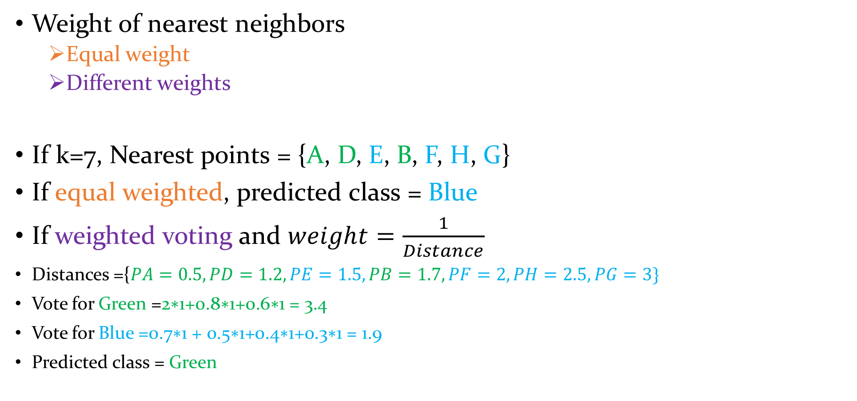
k-Nearest Neighbor Issues
Weight of nearest neighbors
Equal weight
Different weights
If k=7, Nearest points = {A, D, E, B, F, H, G}
If equal weighted, predicted class = Blue
If weighted voting and $weight=\frac{1}{Distance}$
Distances ={$PA=0.5, PD=1.2, PE=1.5, PB=1.7,PF=2,PH=2.5, PG=3\}$
Vote for Green =$\text{2∗1+0.8∗1+0.6∗1 = 3.4}$
Vote for Blue =$\text{0.7∗1 + 0.5∗1+0.4∗1+0.3∗1 = 1.9}$
Predicted class = Green
G
$$x_{2}$$
F
H
E
P
D
A
B
$$x_{1}$$
C

Slide 6
Document Classification
One type of Text Classification
kNN can be used here!
kNN works fine on structured data but cannot handle unstructured data (Text).
Solution?
Structured representation of Text (Unstructured Data)

Slide 7
Structured Representation of Text
Two Common Techniques
Binary Vector Representation
1/0 bit is used for presence/absence of a word
Bag-of-Word (BoW) Representation
Word (hash id of the word) and frequency of the word is used here

Slide 8





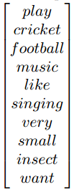
Binary Vector Representation of Text
Vocabulary/
Feature Space
Example Train Documents
Document 1 (Sports): I play cricket. I play football. Document 2 (Music): Play this music. Document 3 (Music): I like singing. Document 4 (Biology): Cricket is a very small insect
Example Text Document
Document t: I want to play music
Create the full vocabulary
Comprising all words of all documents
For each document, create a vector by putting 1 is the word presents in the document, otherwise put 0
Vocabulary -> Fixed length -> Fixed input size (input feature space) -> Structured Representation of Text

Slide 9
Binary Vector Representation of Text
Vocabulary/
Feature Space
Example Train Documents
Document 1 (Sports): I play cricket. I play football. Document 2 (Music): Play this music. Document 3 (Music): I like singing. Document 4 (Biology): Cricket is a very small insect
Example Test Document
Document t: I want to play music
Calculate Hamming Distance from test document to all other train documents and select the k nearest neighbor
hd (Dt,D1)=(0+1+1+1+0+0+0+0+0+1) = 4
hd (Dt,D2) = (0+0+0+0+0+0+0+0+0+1) = 1 hd (Dt,D3) = (1+0+0+1+1+1+0+0+0+1) = 5 hd (Dt,D4) = (1+1+0+1+0+0+1+1+1+1) = 7
If k=1, Nearest Points/Documents ={Music}
Predicted Document Class/Type ={Music}
If k=3, Nearest Points/Documents = {Music, Sports, Music}
Predicted Document Class/Type ={Music}

Slide 10
References
Code Implementation Reference:
https://machinelearningmastery.com/tutorial-to-implement-k-nearest-neighbors-in-python-from-scratch/
Lecture References:
https://machinelearningmastery.com/parametric-and-nonparametric-machine-learning-algorithms/
https://www.analyticsvidhya.com/blog/2018/03/introduction-k-neighbours-algorithm-clustering/
https://www.geeksforgeeks.org/weighted-k-nn/
Lecture Note by Madhusudan Basak

